Slide 1
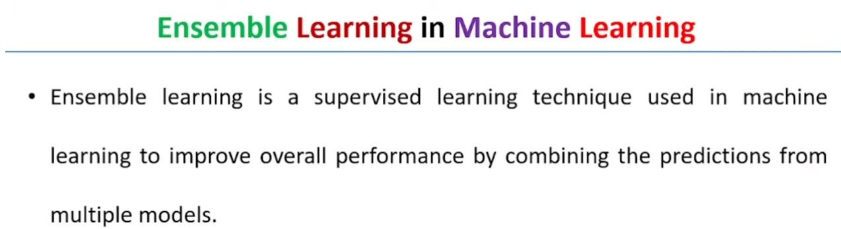
Ensemble means group or collection
A collection of machine learning models.
New model is generated from collection of ML models

Slide 2
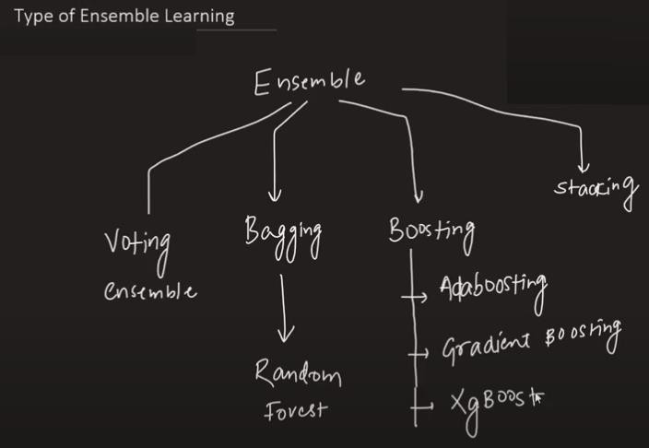

Slide 3
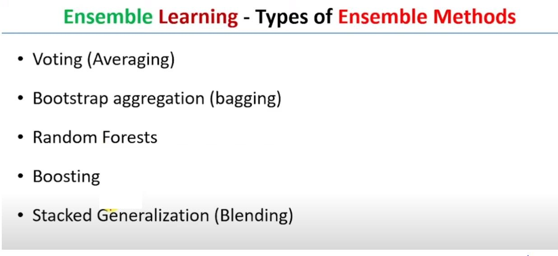

Slide 4
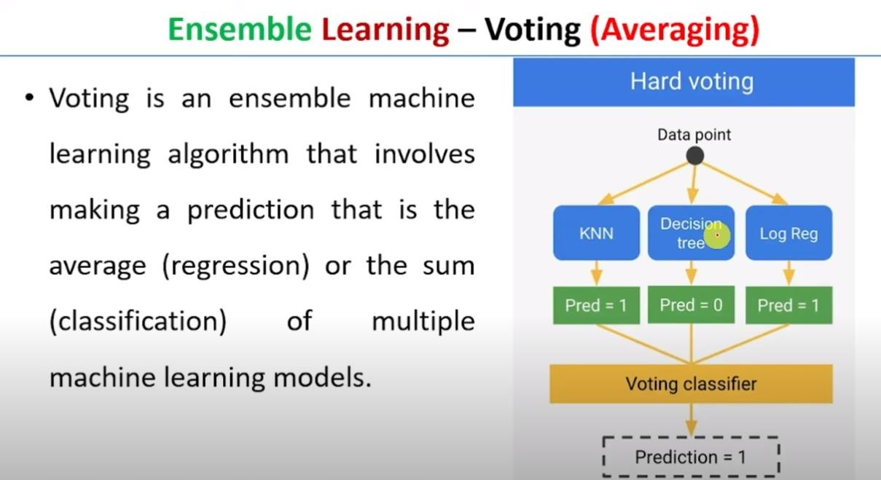

Slide 5
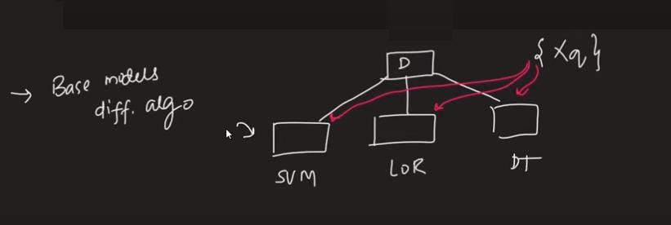

Voting

Slide 6
Bagging
Bagging is a method of ensemble modeling, which is primarily used to solve supervised machine learning problems. It is generally completed in two steps as follows:
Bootstrapping: It is a random sampling method that is used to derive samples from the data using the replacement procedure. In this method, first, random data samples are fed to the primary model, and then a base learning algorithm is run on the samples to complete the learning process.
Aggregation: This is a step that involves the process of combining the output of all base models and, based on their output, predicting an aggregate result with greater accuracy and reduced variance.

Slide 7
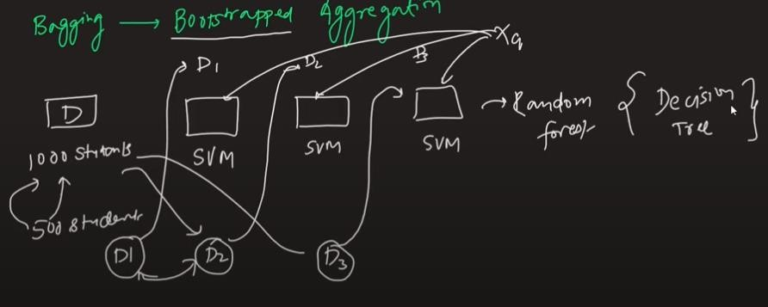
Bagging

Slide 8
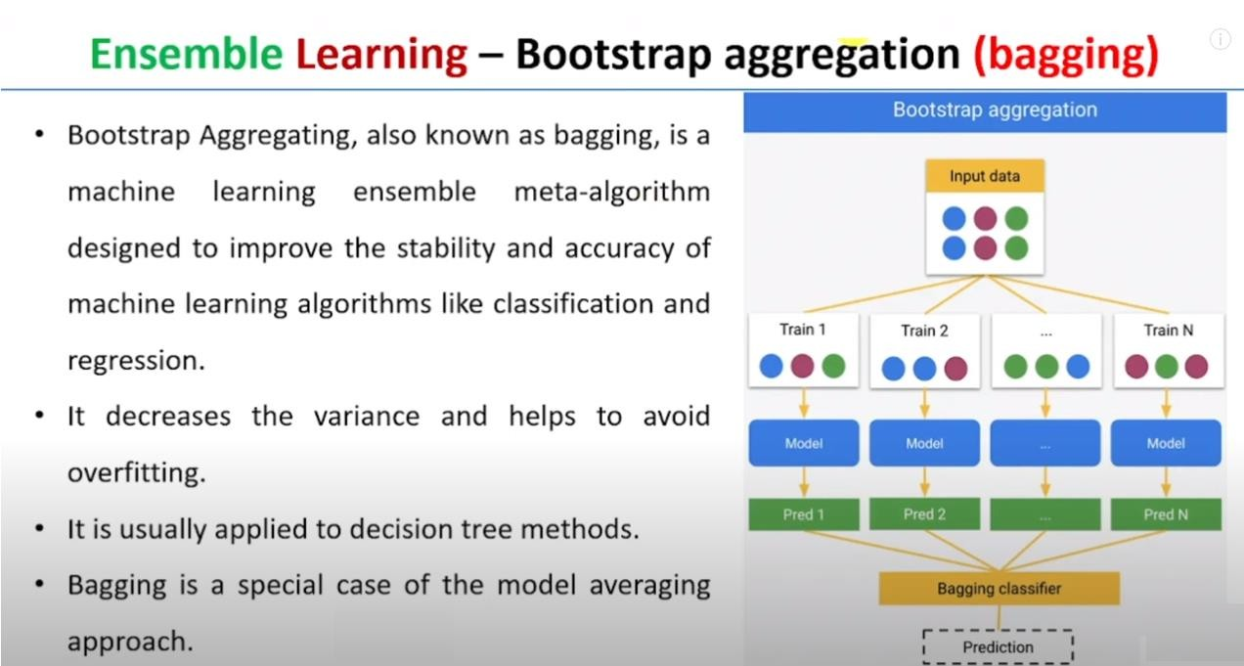

Slide 9
Bias, Variance, Overfitting, Underfitting
Bias
: Training errors
Variance :
Testing errors
:
Training errors : Low
Testing errors : High
Overfitting
Underfitting :
Training errors : High
Testing errors : Low

Slide 10
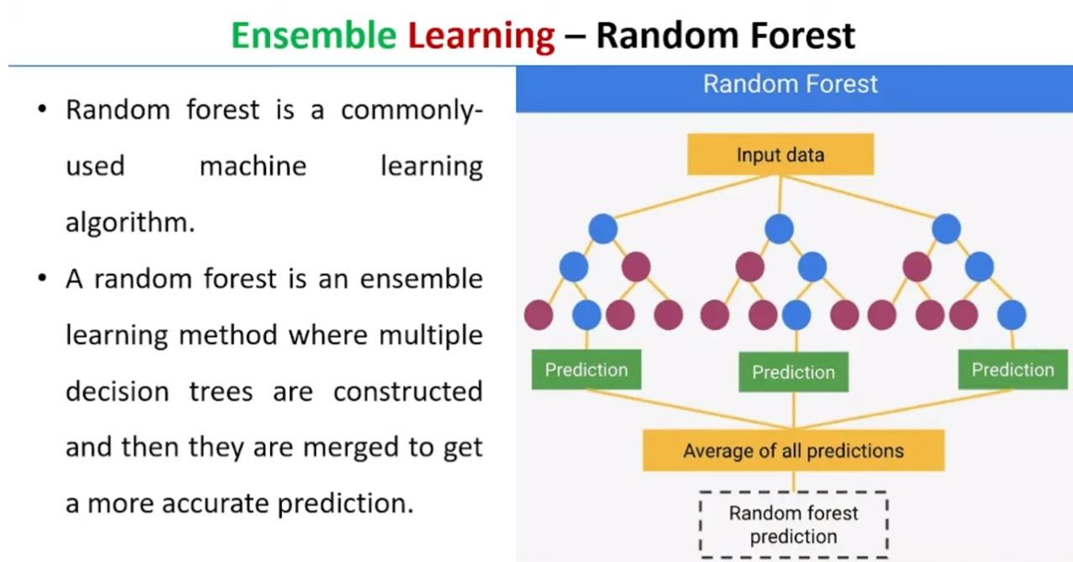

Slide 11
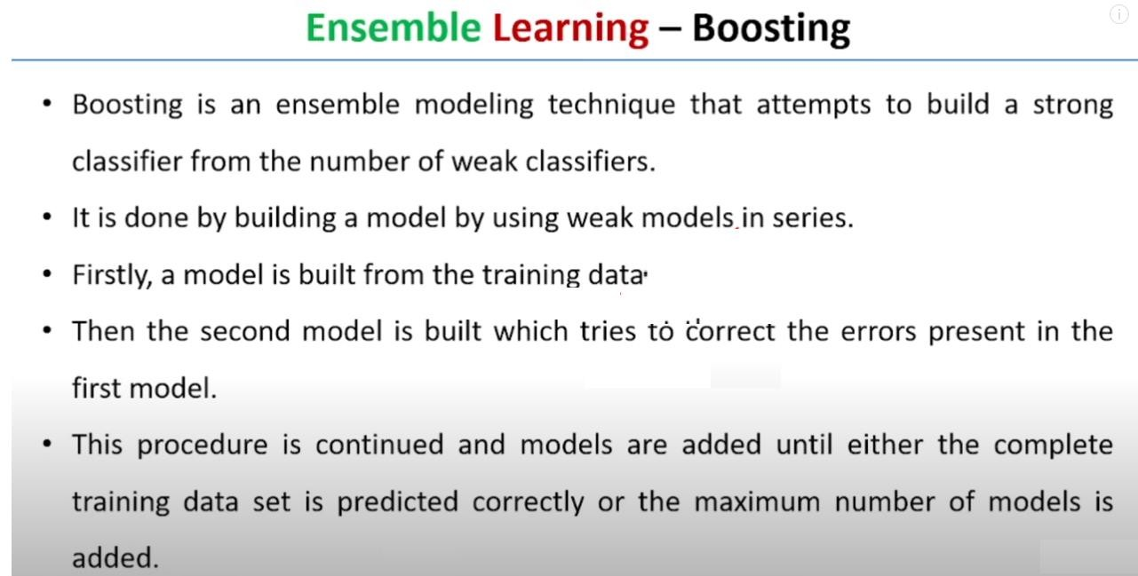
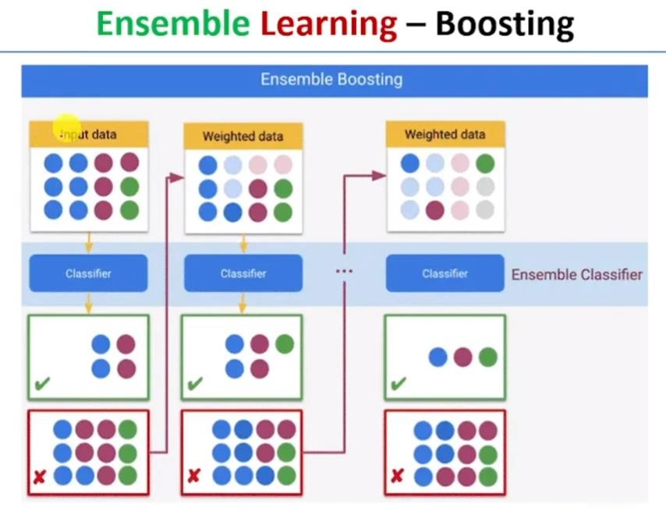

Slide 12
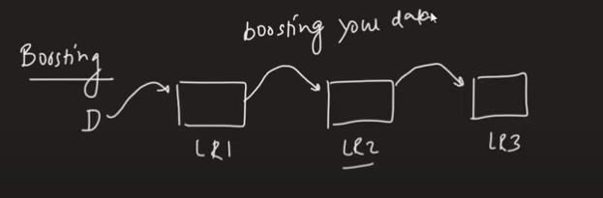
Boosting

Slide 13
Stacking in Ensemble Learning
Heterogeneous weak learners. E.g. Regression, SVM, KNN etc.
Meta Model.
Stacking enables us to train multiple models to solve similar problems, and based on their combined output, it builds a new model with improved performance.

Slide 14
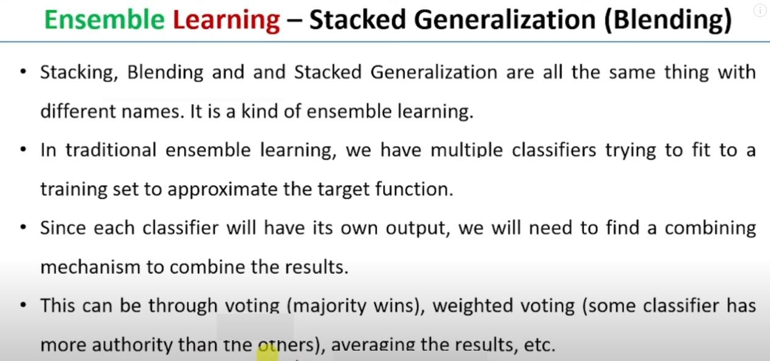

Slide 15
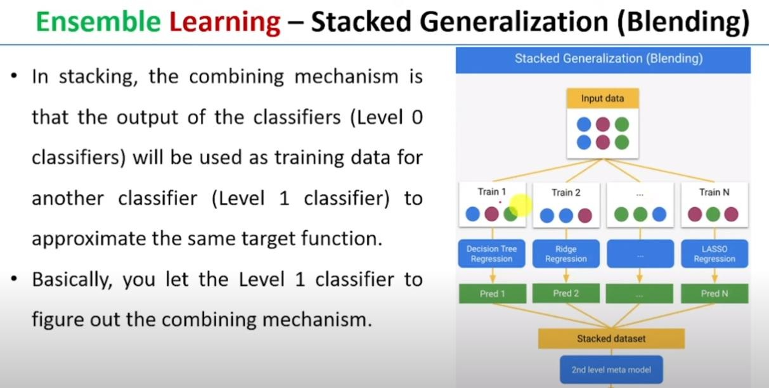

Slide 16
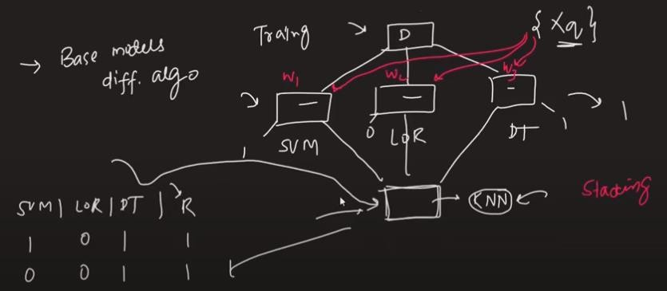
Stacking

